Slide 1
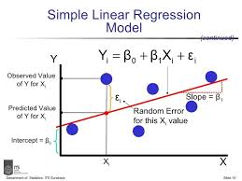
Week 18
Simple Linear Regression

Slide 2
Learning objectives
Distinguish between deterministic and probabilistic relations.
Understand the concepts of correlation and regression.
Be able to fit a simple linear model.
Understand the method of least squares.
Interpret regression coefficients.

Slide 3
Deterministic (Functional) Relationship
A functional relation between two variables is expressed by a mathematical formula. If X denotes the independent variable and Y the dependent variable, a functional relation is of the form: Y = f(X)

Slide 4
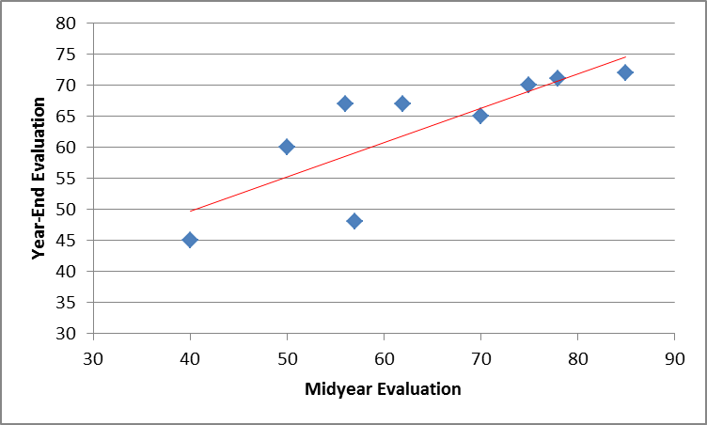
Probabilistic (Statistical) Relationship
A probabilistic relationship, unlike a deterministic one, is not a perfect one. In general, the observations for a probabilistic relation do not fall directly on-the curve of relationship.
Probabilistic = Deterministic + Random Error

Slide 5
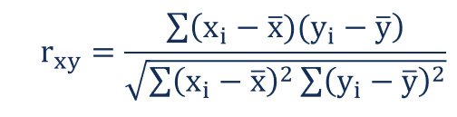
Correlation
The correlation measures the direction and strength of the linear relationship between two quantitative variables. It is usually written as r.
Excel function to calculate correlation: “=correl(array1, array2)”
Correlation always satisfies -1 ≤ r ≤ 1.
Perfect correlation, r = ± 1, occurs only when the points lie exactly on a straight line.
Correlation ignores the distinction between explanatory (independent) and response (dependent) variables.
Correlation is not resistant, so outliers can greatly change the value of r.

Slide 6
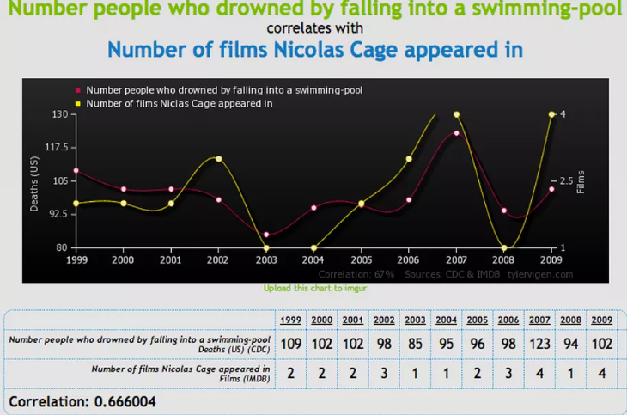
Correlation is not causation

Slide 7
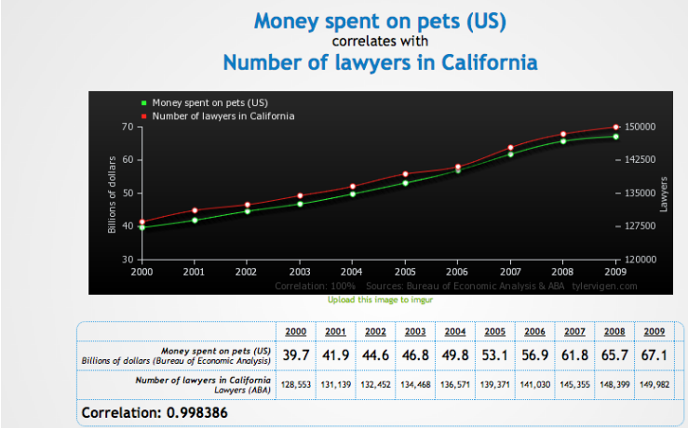
Another Example

Slide 8
Historical Origins of Regression
Regression analysis was first developed by Sir Francis Galton in the latter part of the 19th century. Galton had studied the relation between heights of parents and children and noted that the heights of children of both tall and short parents appeared to "revert" or "regress" to the mean of the group. He considered this tendency to be a regression to "mediocrity." Galton developed a mathematical description of this regression tendency, the precursor of today's regression models.
The term regression persists to this day to describe statistical relations between variables.

Slide 9
Simple Linear Regression
Simple linear regression is a statistical method that allows us to summarize and study relationships between two quantitative variables:
One variable, denoted x, is regarded as the predictor, explanatory, or independent variable.
The other variable, denoted y, is regarded as the response, outcome, or dependent variable.
It is called “simple”, because there is only one predictor variable.
It is called “linear”, because no parameter appears as an exponent or is multiplied or divided by another parameter.

Slide 10
Simple Linear Regression
Basic simple linear model:
Y_{i} = β₀ + β₁X_{i} + ε_{i}
Y_{i} is the value of the response variable in the ith trial.
β₀ and β₁ are parameters.
X_{i} is a known constant, namely, the value of the predictor variable in the ith trial.
ε_{i} is a random error term with mean E{ε_{i}} = 0 and variance σ²{ε_{i}} = σ²; Error terms are uncorrelated with each other.

Slide 11
Meaning of Regression Parameters
β₀ and β₁ are called regression coefficients.
β₁ – slope of the regression line.
It indicates the change in the mean of Y per unit increase of X.
β₀ – Y intercept of the regression line.
When scope of the model includes X=0, β₀ gives mean of Y at X=0. When the scope of the model does not cover X=0, β₀ does not have any particular meaning as a separate term in the model.

Slide 12
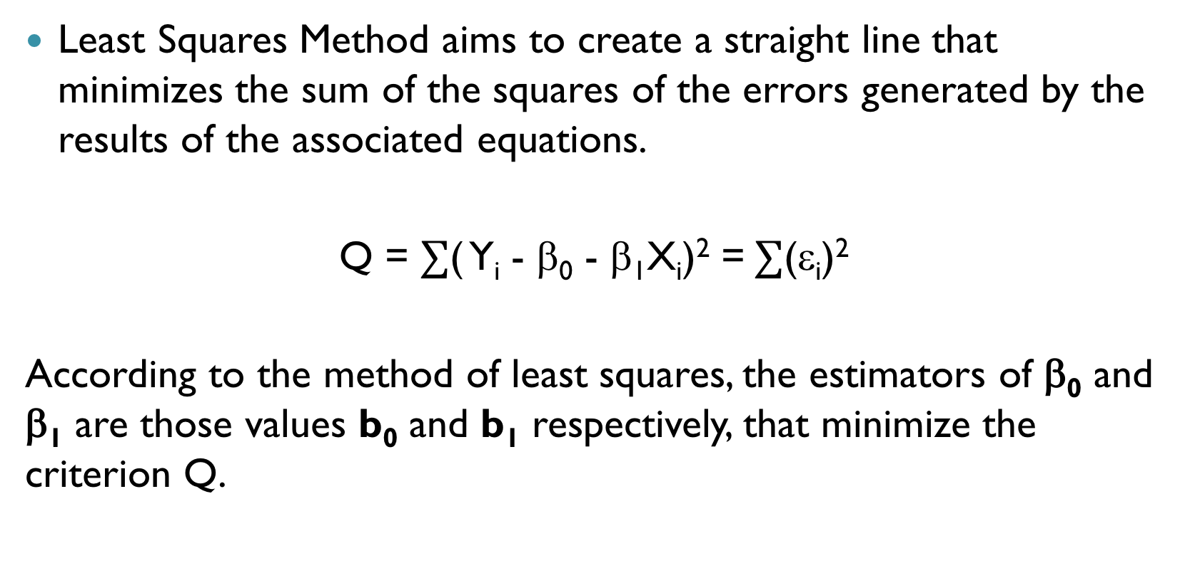
Method of Least Squares
Least Squares Method aims to create a straight line that minimizes the sum of the squares of the errors generated by the results of the associated equations.
Q = $∑$( Y_{i} - β₀ - β₁X_{i})² =$∑$(ε_{i})²
According to the method of least squares, the estimators of β₀ and β₁ are those values b₀ and b₁ respectively, that minimize the criterion Q.

Slide 13
Method of Least Squares

Slide 14
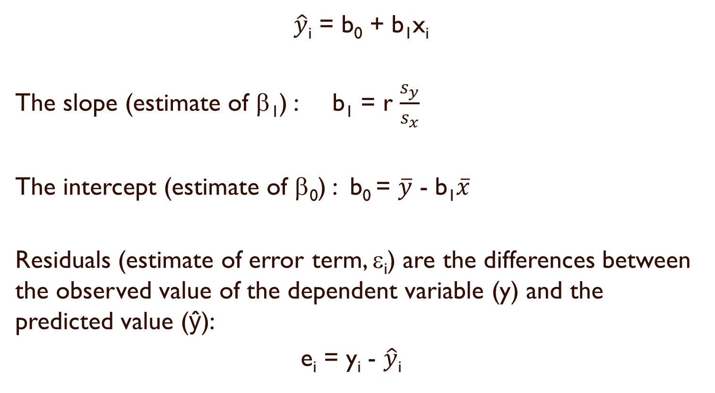
Computing the least-squares regression line.
$\hat{y}$_{i} = b₀ + b₁x_{i}
The slope (estimate of β₁) : b₁ = r $\frac{s_{y}}{s_{x}}$
The intercept (estimate of β₀) : b₀ = $\overline{y}$ - b₁$\overline{x}$
Residuals (estimate of error term, ε_{i}) are the differences between the observed value of the dependent variable (y) and the predicted value (ŷ):
e_{i} = y_{i} - $\hat{y}$_{i}

Slide 15
Simple Linear Regression
Example.
Suppose, we are given price (Y)
and square feet (X) data for
10 houses. Our task is to
construct simple linear
regression model to predict
house price with given square
footage.
House Price in $1000s | Square Feet
(Y) | (X)
245 | 1400
312 | 1600
279 | 1700
308 | 1875
199 | 1100
219 | 1550
405 | 2350
324 | 2450
319 | 1425
255 | 1700

Slide 16
Simple Linear Regression
 | df | SS | MS | F | Significance F
Regression | 1 | 18934.93 | 18934.93 | 11.08 | 0.01
Residual | 8 | 13665.57 | 1708.20
Total | 9 | 32600.50
 | Coefficients | Standard Error | t Stat | P-value | Lower 95% | Upper 95%
Intercept | 98.25 | 58.03 | 1.69 | 0.13 | -35.58 | 232.07
(X) | 0.11 | 0.03 | 3.33 | 0.01 | 0.03 | 0.19
Regression equation:
House Price (Y) = 98.25 + 0.11 * Square Feet (X)

Slide 17
Interpretation of b₀
House Price (Y) = 98.25 + 0.11 * Square Feet (X)
b₀ is the estimated mean value of Y when the value of X is zero (if X = 0 is in the range of observed X values)
Because the square footage of the house cannot be 0, the Y intercept has no practical application.

Slide 18
Interpretation of b₁
House Price (Y) = 98.25 + 0.11 * Square Feet (X)
b₁ measures the mean change in the average value of Y as a result of a one-unit change in X.
Here, b₁ = .11 tells us that the mean value of a house increases by .11($1000) = $110, on average, for each additional one square foot of size.

